Slide 1

Java Fundamentals

Slide 2
Learning Objectives

Slide 3
What is Java
Java is a programming language and a platform. Java is a high level, robust, object-oriented and secure programming language.
Java was developed by Sun Microsystems (which is now the subsidiary of Oracle) in the year 1995. James Gosling is known as the father of Java. Before Java, its name was Oak. Since Oak was already a registered company, so James Gosling and his team changed the Oak name to Java.
Notes:
Audio Script:
GD Instruction:

Slide 4
History of Java
Java was originally designed for interactive television, but it was too advanced technology for the digital cable television industry at the time.
The history of Java starts with the Green Team. Java team members (also known as Green Team), initiated this project to develop a language for digital devices such as set-top boxes, televisions, etc.
Later, Java technology was incorporated by Netscape.
James Gosling Mike Sheridan, and Patrick Naughton initiated the Java language project in June 1991. The small team of sun engineers called Green Team.
Initially designed for small, embedded systems in electronic appliances like set-top boxes.
Firstly, it was called "Greentalk" by James Gosling, and the file extension was .gt.
After that, it was called Oak and was developed as a part of the Green project.
In 1995, Oak was renamed as "Java" because it was already a trademark by Oak Technologies.
Notes:
Audio Script:
GD Instruction:

Slide 5
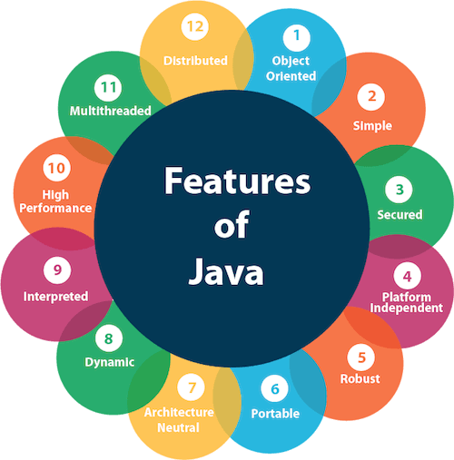
Features of Java
Notes:
Audio Script:
GD Instruction:

Slide 6
JDK
JDK is an acronym for Java Development Kit. The Java Development Kit (JDK) is a software development environment which is used to develop Java applications and applets. It physically exists. It contains JRE + development tools.
Notes:
Audio Script:
GD Instruction:

Slide 7
JRE
JRE is an acronym for Java Runtime Environment. It is also written as Java RTE. The Java Runtime Environment is a set of software tools which are used for developing Java applications. It is used to provide the runtime environment. It is the implementation of JVM. It physically exists. It contains a set of libraries + other files that JVM uses at runtime.
Notes:
Audio Script:
GD Instruction:

Slide 8
JVM
JVM (Java Virtual Machine) is an abstract machine. It is called a virtual machine because it doesn't physically exist. It is a specification that provides a runtime environment in which Java bytecode can be executed. It can also run those programs which are written in other languages and compiled to Java bytecode.
Notes:
Audio Script:
GD Instruction:

Slide 9
Java Variables
A variable is a container which holds the value while the Java program is executed. A variable is assigned with a data type.
Variable is a name of memory location. There are three types of variables in java: local, instance and static.
Variable-
Variable is name of reserved area allocated in memory. In other words, it is a name of memory location. It is a combination of "vary + able" that means its value can be changed.
There are three types of variables in Java:
local variable - declared inside the body of the method is called local variable.
instance variable - declared inside the class but outside the body of the method
static variable - A variable which is declared as static is called static variable. It cannot be local.
Notes:
Audio Script:
GD Instruction:

Slide 10
Java Data Types
Data types specify the different sizes and values that can be stored in the variable. There are two types of data types in Java:
Primitive data types: The primitive data types include
boolean,
char
float
int etc.
Non-primitive data types: The non-primitive data types include
Arrays
Classes
Interfaces etc.
Notes:
Audio Script:
GD Instruction:

Slide 11
Operators in Java
Operator in Java is a symbol which is used to perform operations. For example: +, -, *, / etc.
There are many types of operators in Java which are given below:
Operator Type | Category | Precedence
Unary | postfix | expr++ expr--
 | prefix | ++expr --expr +expr -expr ~ !
Arithmetic | multiplicative | * / %
 | additive | + -
Shift | shift | << >> >>>
Relational | comparison | < > <= >= instanceof
 | equality | == !=
Bitwise | bitwise AND | &
 | bitwise exclusive OR | ^
 | bitwise inclusive OR | |
Logical | logical AND | &&
 | logical OR | ||
Ternary | ternary | ? :
Assignment | assignment | = += -= *= /= %= &= ^= |= <<= >>= >>>=
Notes:
Audio Script:
GD Instruction:

Slide 12
Java Keyword
Java keywords are also known as reserved words. Keywords are particular words which acts as a key to a code. These are predefined words by Java so it cannot be used as a variable or object name.
List of Java Keywords-
abstract | assert | boolean | break | byte | case
catch | char | class | const | continue | default
double | do | else | enum | extends | false
final | finally | float | for | goto | if
implements | import | instanceof | int | interface | long
native | new | null | package | private | protected
public | return | short | static | strictfp | super
switch | synchronized | this | throw | throws | transient
true | try | void | volatile | while
Notes:
Audio Script:
GD Instruction:

Slide 13
Java Control Statements – if else statement
Java if statement is used to test the condition. It checks boolean condition: true or false. There are various types of if statement in Java.
if statement - It executes the if block if condition is true.
if(condition){
//code to be executed
}
2. if-else statement - It executes the if block if condition is true otherwise else block is executed.
if(condition){
//code if condition is true
}else{
//code if condition is false
}
Notes:
Audio Script:
GD Instruction:

Slide 14
Java Control Statements – if else statement
3. if-else-if ladder - executes one condition from multiple statements.
if(condition1){
//code to be executed if condition1 is true
}else if(condition2){
//code to be executed if condition2 is true
}
...
else{
//code to be executed if all the conditions are false
}
4. nested if statement - Its having if statement inside a if statement.
if(condition){
//code to be executed
if(condition){
//code to be executed
}
}
Notes:
Audio Script:
GD Instruction:

Slide 15
Java Control Statements – Ternary Operator
We can also use ternary operator (? :) to perform the task of if...else statement. It is a shorthand way to check the condition. If the condition is true, the result of ? is returned. But, if the condition is false, the result of : is returned.
String output=(number%2==0)?"even number":"odd number";
System.out.println(output);
Notes:
Audio Script:
GD Instruction:

Slide 16
Java Control Statements – Switch
The Java switch statement executes one statement from multiple conditions. It is like if-else-if ladder statement. The switch statement works with byte, short, int, long, enum types, String and some wrapper types like Byte, Short, Int, and Long.
switch(expression){
case value1:
//code to be executed;
break; //optional
case value2:
//code to be executed;
break; //optional
......
default:
code to be executed if all cases are not matched;
}
Notes:
Audio Script:
GD Instruction:

Slide 17
Java Loop - for
The Java for loop is a control flow statement that iterates a part of the programs multiple times.
If the number of iteration is fixed, it is recommended to use for loop.
for(int i=1;i<=10;i++){ System.out.println(i); }
Notes:
Audio Script:
GD Instruction:

Slide 18
Java Loop - while
The Java while loop is a control flow statement that executes a part of the programs repeatedly on the basis of given boolean condition.
If the number of iteration is not fixed, it is recommended to use while loop.
int i=1; while(i<=10){ System.out.println(i); i++; }
Notes:
Audio Script:
GD Instruction:

Slide 19
Java Loop – do … while
The Java do while loop is a control flow statement that executes a part of the programs at least once and the further execution depends upon the given boolean condition.
If the number of iteration is not fixed and you must have to execute the loop at least once, it is recommended to use the do-while loop.
int i=1; do{ System.out.println(i); i++; }while(i<=10);
Notes:
Audio Script:
GD Instruction:

Slide 20
Java Naming Conventions
Java naming convention is a rule to follow as you decide what to name your identifiers such as class, package, variable, constant, method, etc.
All the classes, interfaces, packages, methods and fields of Java programming language are given according to the Java naming convention. If you fail to follow these conventions, it may generate confusion or erroneous code.
Advantage of naming conventions in java-
By using standard Java naming conventions, you make your code easier to read for yourself and other programmers. Readability of Java program is very important. It indicates that less time is spent to figure out what the code does.
The following are the key rules that must be followed by every identifier:
The name must not contain any white spaces.
The name should not start with special characters like & (ampersand), $ (dollar), _ (underscore).
Notes:
Audio Script:
GD Instruction:

Slide 21
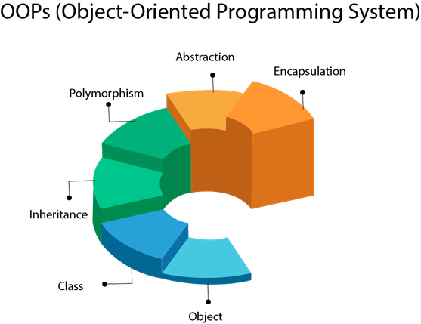
Java OOPs Concepts
Object means a real-world entity such as a pen, chair, table, computer, watch, etc. Object-Oriented Programming is a methodology or paradigm to design a program using classes and objects. It simplifies software development and maintenance by providing some concepts:
Notes:
Audio Script:
GD Instruction:

Slide 22
Java Class Naming Conventions
It should start with the uppercase letter.
It should be a noun such as Color, Button, System, Thread, etc.
Use appropriate words, instead of acronyms.
Example: -
public class Employee { //code snippet }
Notes:
Audio Script:
GD Instruction:

Slide 23
Java Interface Naming Conventions
It should start with the uppercase letter.
It should be an adjective such as Runnable, Remote, ActionListener.
Use appropriate words, instead of acronyms.
Example: -
interface Printable { //code snippet }
Notes:
Audio Script:
GD Instruction:

Slide 24
Java Method Naming Conventions
It should start with lowercase letter.
It should be a verb such as main(), print(), println().
If the name contains multiple words, start it with a lowercase letter followed by an uppercase letter such as actionPerformed().
Example:-
class Employee { //method void draw() { //code snippet } }
Notes:
Audio Script:
GD Instruction:

Slide 25
Java Variable Naming Conventions
It should start with a lowercase letter such as id, name.
It should not start with the special characters like & (ampersand), $ (dollar), (underscore).
If the name contains multiple words, start it with the lowercase letter followed by an uppercase letter such as firstName, lastName.
Avoid using one-character variables such as x, y, z.
Example :-
class Employee { //variable int id; //code snippet }
Notes:
Audio Script:
GD Instruction:

Slide 26
Java Package Naming Conventions
It should be a lowercase letter such as java, lang.
If the name contains multiple words, it should be separated by dots (.) such as java.util, java.lang.
Example :-
package com.javatpoint; //package class Employee { //code snippet }
Notes:
Audio Script:
GD Instruction:

Slide 27
Java Constants Naming Conventions
It should be in uppercase letters such as RED, YELLOW.
If the name contains multiple words, it should be separated by an underscore(_) such as MAX_PRIORITY.
It may contain digits but not as the first letter.
Example :-
class Employee { //constant static final int MIN_AGE = 18; //code snippet }
Notes:
Audio Script:
GD Instruction:

Slide 28
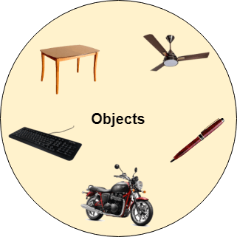
Object
Any entity that has state and behavior is known as an object. For example, a chair, pen, table, keyboard, bike, etc. It can be physical or logical.
An Object can be defined as an instance of a class. An object contains an address and takes up some space in memory. Objects can communicate without knowing the details of each other's data or code.
Example: A dog is an object because it has states like color, name, breed, etc. as well as behaviors like wagging the tail, barking, eating, etc.
State : It is represented by attributes of an object. It also reflects the properties of an object.
Behavior : It is represented by methods of an object. It also reflects the response of an object with other objects.
Identity : It gives a unique name to an object and enables one object to interact with other objects.
Notes:
Audio Script:
GD Instruction:

Slide 29
Class
Collection of objects is called class. It is a logical entity.
A class can also be defined as a blueprint from which you can create an individual object. Class doesn't consume any space. In general, class declarations can include these components, in order:
Modifiers : A class can be public or has default access (Refer this for details).
Class name: The name should begin with a initial letter (capitalized by convention).
Superclass(if any): The name of the class’s parent (superclass), if any, preceded by the keyword extends. A class can only extend (subclass) one parent.
Interfaces(if any): A comma-separated list of interfaces implemented by the class, if any, preceded by the keyword implements. A class can implement more than one interface.
Body: The class body surrounded by braces, { }.
Class[class_name]{ field; method; }
Notes:
Audio Script:
GD Instruction:

Slide 30
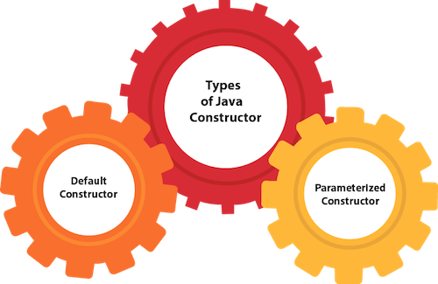
Constructor
A constructor is a block of codes similar to the method. It is called when an instance of the class is created. At the time of calling constructor, memory for the object is allocated in the memory.
It is a special type of method which is used to initialize the object.
Every time an object is created using the new() keyword, at least one constructor is called.
There are three rules defined for the constructor.
Constructor name must be the same as its class name
A Constructor must have no explicit return type
A Java constructor cannot be abstract, static, final, and synchronized
Notes:
Audio Script:
GD Instruction:

Slide 31
Java Default Constructor
A constructor is called "Default Constructor" when it doesn't have any parameter.
//Java Program to create and call a default constructor class Bike1 { //creating a default constructor Bike1() { System.out.println("Bike is created"); } //main method public static void main(String args[]) { //calling a default constructor Bike1 b = new Bike1(); } }
Notes:
Audio Script:
GD Instruction:

Slide 32
Java Parameterized Constructor
A constructor which has a specific number of parameters is called a parameterized constructor.
//Java Program to demonstrate the use of the parameterized constructor. class Student4 { int id; String name; //creating a parameterized constructor Student4(int i, String n) { id = i; name = n; } public static void main(String args[]) { //creating objects and passing values Student4 s1 = new Student4(111, "Karan"); Student4 s2 = new Student4(222, "Aryan"); } }
Notes:
Audio Script:
GD Instruction:

Slide 33
Java static keyword
The static keyword in Java is used for memory management mainly. We can apply static keyword with variables, methods, blocks and nested classes.
The static keyword belongs to the class than an instance of the class.
The static can be:
Variable (also known as a class variable)
Method (also known as a class method)
Block
Nested class
Static variable
The static variable can be used to refer to the common property of all objects (which is not unique for each object), for example, the company name of employees, college name of students, etc.
The static variable gets memory only once in the class area at the time of class loading.
Notes:
Audio Script:
GD Instruction:

Slide 34
Java this keyword
There can be a lot of usage of java this keyword. In java, this is a reference variable that refers to the current object.
Here is given the 6 usage of java this keyword.
this can be used to refer current class instance variable.
this can be used to invoke current class method (implicitly)
this() can be used to invoke current class constructor.
this can be passed as an argument in the method call.
this can be passed as argument in the constructor call.
this can be used to return the current class instance from the method.
Notes:
Audio Script:
GD Instruction:

Slide 35
Inheritance in Java
The idea behind inheritance in Java is that you can create new classes that are built upon existing classes. When you inherit from an existing class, you can reuse methods and fields of the parent class. Moreover, you can add new methods and fields in your current class also.
Inheritance represents the IS-A relationship which is also known as a parent-child relationship.
class SubClass extends SuperClass { //methods and fields }
Notes:
Audio Script:
GD Instruction:

Slide 36
Types of Inheritance
1. Single Inheritance- When a class inherits another class, it is known as a single inheritance. In the example given below, Dog class inherits the Animal class, so there is the single inheritance.
class Animal { void eat() { System.out.println("eating..."); } } class Dog extends Animal { void bark() { System.out.println("barking..."); } }
class TestInheritance { public static void main(String args[]) { Dog d = new Dog(); d.bark(); d.eat(); } }
Notes:
Audio Script:
GD Instruction:

Slide 37
Types of Inheritance
2. Multilevel Inheritance- When there is a chain of inheritance, it is known as multilevel inheritance. As you can see in the example given below, BabyDog class inherits the Dog class which again inherits the Animal class, so there is a multilevel inheritance.
class BabyDog extends Dog { void weep() { System.out.println("weeping..."); } } class TestInheritance2 { public static void main(String args[]) { BabyDog d = new BabyDog(); d.weep(); d.bark(); d.eat(); } }
class Animal { void eat() { System.out.println("eating..."); } } class Dog extends Animal { void bark() { System.out.println("barking..."); } }
Notes:
Audio Script:
GD Instruction:

Slide 38
Types of Inheritance
3. Hierarchical Inheritance- When two or more classes inherits a single class, it is known as hierarchical inheritance. In the example given below, Dog and Cat classes inherits the Animal class, so there is hierarchical inheritance.
class Cat extends Animal { void meow() { System.out.println("meowing..."); } } class TestInheritance3 { public static void main(String args[]) { Cat c = new Cat(); c.meow(); c.eat(); //c.bark();//C.T.Error } }
class Animal { void eat() { System.out.println("eating..."); } } class Dog extends Animal { void bark() { System.out.println("barking..."); } }
Notes:
Audio Script:
GD Instruction:

Slide 39
Polymorphism
Polymorphism in Java is a concept by which we can perform a single action in different ways. Polymorphism is derived from 2 Greek words: poly and morphs.
The word "poly" means many and "morphs" means forms. So polymorphism means many forms.
There are two types of polymorphism in Java: compile-time polymorphism and runtime polymorphism.
We can perform polymorphism in java by method overloading and method overriding.
Notes:
Audio Script:
GD Instruction:

Slide 40
Method Overloading
If a class has multiple methods having same name but different in parameters, it is known as Method Overloading.
If we have to perform only one operation, having same name of the methods increases the readability of the program.
There are two ways to overload the method in java
By changing number of arguments
By changing the data type
class Adder { static int add(int a, int b) { return a + b; } static int add(int a, int b, int c) { return a + b + c; } }
class TestOverloading1 { public static void main(String[] args) { System.out.println(Adder.add(11, 11)); System.out.println(Adder.add(11, 11, 11)); } }
Notes:
Audio Script:
GD Instruction:

Slide 41
Method Overriding
If subclass (child class) has the same method as declared in the parent class, it is known as method overriding in Java.
In other words, If a subclass provides the specific implementation of the method that has been declared by one of its parent class, it is known as method overriding.
Rules for Java Method Overriding
The method must have the same name as in the parent class
The method must have the same parameter as in the parent class.
There must be an IS-A relationship (inheritance).
//Creating a child class class Bike2 extends Vehicle { //defining the same method as in the parent class void run() { System.out.println("Bike is running safely"); } public static void main(String args[]) { Bike2 obj = new Bike2();//creating object obj.run();//calling method } }
//Creating a parent class. class Vehicle { //defining a method void run() { System.out.println("Vehicle is running"); } }
Notes:
Audio Script:
GD Instruction:

Slide 42
Super keyword
The super keyword in Java is a reference variable which is used to refer immediate parent class object.
Whenever you create the instance of subclass, an instance of parent class is created implicitly which is referred by super reference variable.
Usage of Java super Keyword
super can be used to refer immediate parent class instance variable.
super can be used to invoke immediate parent class method.
super() can be used to invoke immediate parent class constructor.
class Emp extends Person { float salary; Emp(int id, String name, float salary) { super(id, name);//reusing parent constructor this.salary = salary; } void display() { System.out.println(id + " " + name + " " + salary); } }
class Person { int id; String name; Person(int id, String name) { this.id = id; this.name = name; } }
class TestSuper5 { public static void main(String[] args) { Emp e1 = new Emp(1, "ankit", 45000f); e1.display(); } }
Notes:
Audio Script:
GD Instruction:

Slide 43
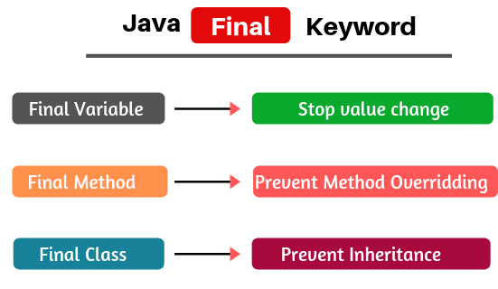
Final keyword
The final keyword in java is used to restrict the user. The java final keyword can be used in many context. Final can be:
variable
method
class
Notes:
Audio Script:
GD Instruction:

Slide 44
Abstract class in Java
Abstraction is a process of hiding the implementation details and showing only functionality to the user.
Ways to achieve Abstraction :
There are two ways to achieve abstraction in java
Abstract class (0 to 100%)
Interface (100%)
A class which is declared as abstract is known as an abstract class. It can have abstract and non-abstract methods. It needs to be extended and its method implemented. It cannot be instantiated.
Points to Remember
An abstract class must be declared with an abstract keyword.
It can have abstract and non-abstract methods.
It cannot be instantiated.
It can have constructors and static methods also.
It can have final methods which will force the subclass not to change the body of the method.
Example of abstract class
abstract class A{}
Notes:
Audio Script:
GD Instruction:

Slide 45
Abstract Method in Java
A method which is declared as abstract and does not have implementation is known as an abstract method.
Example of abstract method
Example of Abstract class that has an abstract method
abstract void printStatus();//no method body and abstract
abstract class Bike{
abstract void run();
}
class Honda4 extends Bike{
void run(){System.out.println("running safely");}
public static void main(String args[]){
Bike obj = new Honda4();
obj.run();
}
}
Notes:
Audio Script:
GD Instruction:

Slide 46
Interface in Java
An interface in Java is a blueprint of a class. It has static constants and abstract methods.
The interface in Java is a mechanism to achieve abstraction. There can be only abstract methods in the Java interface, not method body. It is used to achieve abstraction and multiple inheritance in Java.
Why use Java interface?
There are mainly three reasons to use interface. They are given below.
It is used to achieve abstraction.
By interface, we can support the functionality of multiple inheritance.
It can be used to achieve loose coupling.
An interface is declared by using the interface keyword. It provides total abstraction; means all the methods in an interface are declared with the empty body, and all the fields are public, static and final by default. A class that implements an interface must implement all the methods declared in the interface.
How to declare an interface?
Notes:
Audio Script:
GD Instruction:

Slide 47
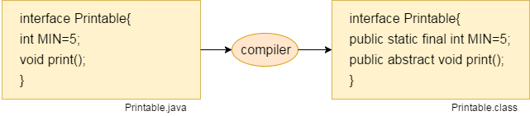
Syntax:
interface <interfacename>{
// declare constant fields
// declare methods that abstract
// by default.
}
In other words, Interface fields are public, static and final by default, and the methods are public and abstract.
Notes:
Audio Script:
GD Instruction:

Slide 48
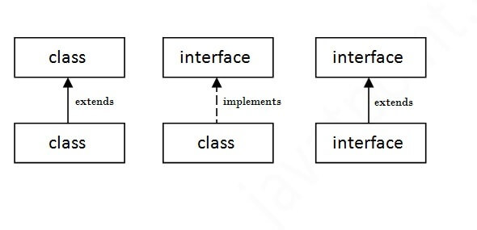
The relationship between classes and interfaces
As shown in the figure given below, a class extends another class, an interface extends another interface, but a class implements an interface.
Java Interface Example
interface printable{
void print();
}
class A6 implements printable{
public void print(){System.out.println("Hello");}
public static void main(String args[]){
A6 obj = new A6();
obj.print();
}
}
Notes:
Audio Script:
GD Instruction:

Slide 49
Encapsulation in Java
Encapsulation in Java is a process of wrapping code and data together into a single unit, for example, a capsule which is mixed of several medicines.
We can create a fully encapsulated class in Java by making all the data members of the class private. Now we can use setter and getter methods to set and get the data in it.
Advantage of Encapsulation in Java
By providing only a setter or getter method, you can make the class read-only or write-only. In other words, you can skip the getter or setter methods.
It is a way to achieve data hiding in Java because other class will not be able to access the data through the private data members.
The encapsulate class is easy to test. So, it is better for unit testing.
The standard IDE's are providing the facility to generate the getters and setters. So, it is easy and fast to create an encapsulated class in Java.
Notes:
Audio Script:
GD Instruction:

Slide 50
Simple Example of Encapsulation in Java
File: Student.java
File: Test.java
//A Java class which is a fully encapsulated class.
//It has a private data member and getter and setter methods.
package com.javatpoint;
public class Student{
//private data member
private String name;
//getter method for name
public String getName(){
return name;
}
//setter method for name
public void setName(String name){
this.name=name
}
}
//A Java class to test the encapsulated class.
package com.javatpoint;
class Test{
public static void main(String[] args){
//creating instance of the encapsulated class
Student s=new Student();
//setting value in the name member
s.setName("vijay");
//getting value of the name member
System.out.println(s.getName());
}
}

Slide 51
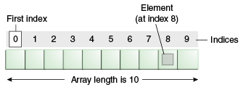
Java Array
Normally, an array is a collection of similar type of elements which have a contiguous memory location.
Java array is an object which contains elements of a similar data type. Additionally, The elements of an array are stored in a contiguous memory location. It is a data structure where we store similar elements. We can store only a fixed set of elements in a Java array.
Array in Java is index-based, the first element of the array is stored at the 0th index, 2nd element is stored on 1st index and so on
There are two types of array.
Single Dimensional Array
Multidimensional Array

Slide 52
Java Array Example
//Java Program to illustrate how to declare, instantiate, initialize //and traverse the Java array. class Testarray { public static void main(String args[]) { int a[] = new int[5];//declaration and instantiation a[0] = 10;//initialization a[1] = 20; a[2] = 70; a[3] = 40; a[4] = 50; //traversing array for (int i = 0; i < a.length; i++)//length is the property of array System.out.println(a[i]); } }

Slide 53
Java String
In Java, string is basically an object that represents sequence of char values. An array of characters works same as Java string.
For example:
is same as:
Java String class provides a lot of methods to perform operations on strings such as compare(), concat(), equals(), split(), length(), replace(), compareTo(), intern(), substring() etc.
char[] ch={‘m',‘o',‘h','a',‘n',‘j',‘a',‘y',‘a'};
String s=new String(ch);
String s=“mohanjaya";

Slide 54
What is String in java ?
Generally, String is a sequence of characters. But in Java, string is an object that represents a sequence of characters. The java.lang.String class is used to create a string object.
How to create a string object?
There are two ways to create String object:
By string literal
By new keyword
Java String literal is created by using double quotes. For Example:
String s="welcome";
String s=new String("Welcome");//creates two objects and one reference variable
String Literal
2) By new keyword

Slide 55
Java String Example
public class StringExample
{
public static void main(String args[])
{
String s1="java";//creating string by java string literal
char ch[]={'s','t','r','i','n','g','s'};
String s2=new String(ch);//converting char array to string
String s3=new String("example");//creating java string by new keyword
System.out.println(s1);
System.out.println(s2);
System.out.println(s3);
}
}

Slide 56
Java String compare
We can compare string in java on the basis of content and reference.
It is used in authentication (by equals() method), sorting (by compareTo() method), reference matching (by == operator) etc.
There are three ways to compare string in java:
By equals() method
By = = operator
By compareTo() method

Slide 57
1) String compare by equals() method
The String equals() method compares the original content of the string. It compares values of string for equality. String class provides two methods:
public boolean equals(Object another) compares this string to the specified object.
public boolean equalsIgnoreCase(String another) compares this String to another string, ignoring case.
class Teststringcomparison1{
public static void main(String args[]){
String s1="Sachin";
String s2="Sachin";
String s3=new String("Sachin");
String s4="Saurav";
System.out.println(s1.equals(s2));//true
System.out.println(s1.equals(s3));//true
System.out.println(s1.equals(s4));//false
}
}

Slide 58
2) String compare by == operator
The = = operator compares references not values.
class Teststringcomparison3{
public static void main(String args[]){
String s1="Sachin";
String s2="Sachin";
String s3=new String("Sachin");
System.out.println(s1==s2);//true (because both refer to same instance)
System.out.println(s1==s3);//false(because s3 refers to instance created in nonpool)
}
}

Slide 59
3) String compare by compareTo() method
The String compareTo() method compares values lexicographically and returns an integer value that describes if first string is less than, equal to or greater than second string.
Suppose s1 and s2 are two string variables. If:
s1 == s2 :0
s1 > s2 :positive value
s1 < s2 :negative value
class Teststringcomparison4{
public static void main(String args[]){
String s1="Sachin";
String s2="Sachin";
String s3="Ratan";
System.out.println(s1.compareTo(s2));//0
System.out.println(s1.compareTo(s3));//1(because s1>s3)
System.out.println(s3.compareTo(s1));//-1(because s3 < s1 )
}
}

Slide 60
String Concatenation in Java
In java, string concatenation forms a new string that is the combination of multiple strings. There are two ways to concat string in java:
By + (string concatenation) operator
By concat() method
1) String Concatenation by + (string concatenation) operator
Java string concatenation operator (+) is used to add strings. For Example:
class TestStringConcatenation1{
public static void main(String args[]){
String s="Sachin"+" Tendulkar";
System.out.println(s);//Sachin Tendulkar
}
}

Slide 61
String Concatenation by concat() method
The String concat() method concatenates the specified string to the end of current string. Syntax:
public String concat(String another)
class TestStringConcatenation3{
public static void main(String args[]){
String s1="Sachin ";
String s2="Tendulkar";
String s3=s1.concat(s2);
System.out.println(s3);//Sachin Tendulkar
}
}

Slide 62
String most used methods
char charAt(int index): It returns the character at the specified index. Specified index value should be between 0 to length() -1 both inclusive. It throws IndexOutOfBoundsException if index<0||>= length of String.
boolean equals(Object obj): Compares the string with the specified string and returns true if both matches else false.
boolean equalsIgnoreCase(String string): It works same as equals method but it doesn’t consider the case while comparing strings. It does a case insensitive comparison.
int compareTo(String string): This method compares the two strings based on the Unicode value of each character in the strings.
int compareToIgnoreCase(String string): Same as CompareTo method however it ignores the case during comparison.
boolean startsWith(String prefix, int offset): It checks whether the substring (starting from the specified offset index) is having the specified prefix or not.
boolean startsWith(String prefix): It tests whether the string is having specified prefix, if yes then it returns true else false.
boolean endsWith(String suffix): Checks whether the string ends with the specified suffix.

Slide 63
Exception Handling
The Exception Handling in Java is one of the powerful mechanism to handle the runtime errors so that normal flow of the application can be maintained.
In Java, an exception is an event that disrupts the normal flow of the program. It is an object which is thrown at runtime.
There are mainly two types of exceptions: checked and unchecked. Here, an error is considered as the unchecked exception. According to Oracle, there are three types of exceptions:
Checked Exception - The classes which directly inherit Throwable class except RuntimeException and Error are known as checked exceptions e.g. IOException, SQLException etc. Checked exceptions are checked at compile-time.
Unchecked Exception - The classes which inherit RuntimeException are known as unchecked exceptions e.g. ArithmeticException, NullPointerException, ArrayIndexOutOfBoundsException
Error - Error is irrecoverable e.g. OutOfMemoryError, VirtualMachineError, AssertionError etc.

Slide 64
Java Exception Keywords
Keyword | Description
try | The "try" keyword is used to specify a block where we should place exception code. The try block must be followed by either catch or finally. It means, we can't use try block alone.
catch | The "catch" block is used to handle the exception. It must be preceded by try block which means we can't use catch block alone. It can be followed by finally block later.
finally | The "finally" block is used to execute the important code of the program. It is executed whether an exception is handled or not.
throw | The "throw" keyword is used to throw an exception.
throws | The "throws" keyword is used to declare exceptions. It doesn't throw an exception. It specifies that there may occur an exception in the method. It is always used with method signature.

Slide 65
Try Catch Block
Java try block is used to enclose the code that might throw an exception. It must be used within the method.
If an exception occurs at the particular statement of try block, the rest of the block code will not execute. So, it is recommended not to keeping the code in try block that will not throw an exception
public class TryCatchExample2 { public static void main(String[] args) { try { int data = 50 / 0; //may throw exception } //handling the exception catch (ArithmeticException e) { System.out.println(e); } System.out.println("rest of the code"); } }

Slide 66
Catch multiple exceptions
A try block can be followed by one or more catch blocks. Each catch block must contain a different exception handler. So, if you have to perform different tasks at the occurrence of different exceptions, use java multi-catch block.
public class MultipleCatchBlock1 { public static void main(String[] args) { try { int a[] = new int[5]; a[5] = 30 / 0; } catch (ArithmeticException e) { System.out.println("Arithmetic Exception occurs"); } catch (ArrayIndexOutOfBoundsException e) { System.out.println("ArrayIndexOutOfBounds Exception occurs"); } catch (Exception e) { System.out.println("Parent Exception occurs"); } System.out.println("rest of the code"); } }

Slide 67
Nested Try
class Excep6 { public static void main(String args[]) { try { try { System.out.println("going to divide"); int b = 39 / 0; } catch (ArithmeticException e) { System.out.println(e); } try { int a[] = new int[5]; a[5] = 4; } catch (ArrayIndexOutOfBoundsException e) { System.out.println(e); } } catch (Exception e) { System.out.println("handeled"); } System.out.println("normal flow.."); } }
The try block within a try block is known as nested try block in java.
Sometimes a situation may arise where a part of a block may cause one error and the entire block itself may cause another error. In such cases, exception handlers have to be nested.

Slide 68
Finally Block
Java finally block is a block that is used to execute important code such as closing connection, stream etc.
Java finally block is always executed whether exception is handled or not.
Java finally block follows try or catch block.
class TestFinallyBlock { public static void main(String args[]) { try { int data = 25 / 5; System.out.println(data); } catch (NullPointerException e) { System.out.println(e); } finally { System.out.println("finally block is always executed"); } System.out.println("rest of the code..."); } }

Slide 69
Throw and Throws
The Java throw keyword is used to explicitly throw an exception.
throw new IOException("sorry device error);
The Java throws keyword is used to declare an exception.
It gives an information to the programmer that there may occur an exception so it is better for the programmer to provide the exception handling code so that normal flow can be maintained.
public void print() throws IOException { //method code }

Slide 70
Java IO (File Handling) - OutputStream
import java.io.FileOutputStream; public class FileOutputStreamExample { public static void main(String args[]) { try { FileOutputStream fout = new FileOutputStream("D://testout.txt"); fout.write(65); fout.close(); System.out.println("success..."); } catch (Exception e) { System.out.println(e); } } }

Slide 71


thank you!
Copyright © Knowledgehut., All rights reserved
Confidential Information, intended for approved distribution list of Knowledgehut

